Slide 1
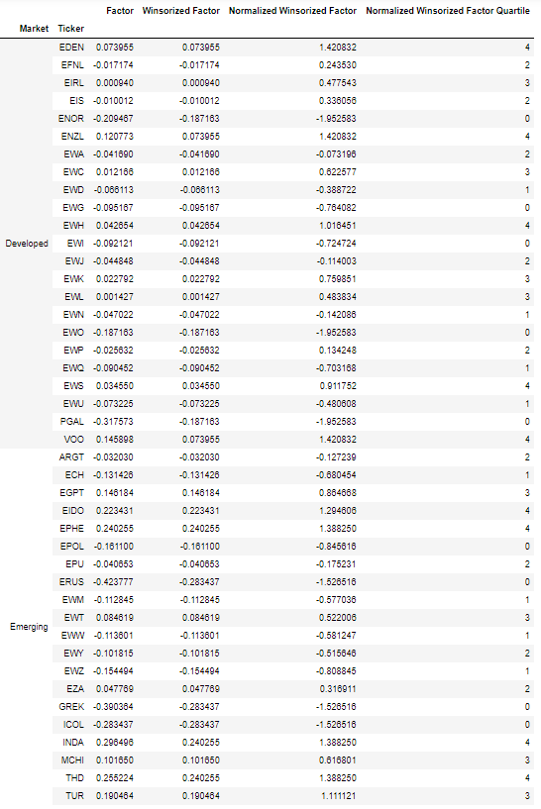
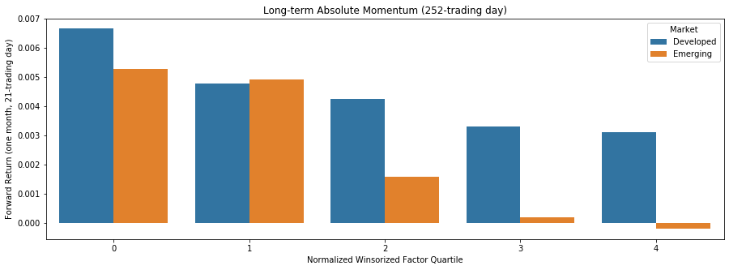
Raw Factor Data
Winsorization
Normalization
Factor Quartile

